Slide 1

https://www.uni-goettingen.de/en/48115.html
Unless I explicitly state otherwise, images and cartoons are created using ChatGPT.
You may use this material free of charge under the terms of the CC BY license. This requires that you provide appropriate attribution to the author: W. Link, University of Goettingen, Germany.
In a few cases, individual images, photographs, or similar material may be subject to a more restrictive Creative Commons license. Where this applies, it is explicitly indicated, and you must comply with the stated license terms for those items.
Please check the license information carefully before reuse. Responsibility for complying with the applicable license terms rests entirely with you.
PopGen_Ch-3
Population Genetics; Inbreeding
1

Slide 2
Sequential Number: #4
UNPLAB-PopGen_Ch-3[Inbreeding]
2

Slide 3
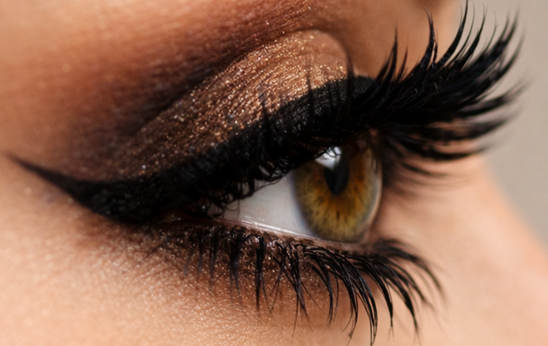
You already know: HWE (Hardy-Weinberg-Equilibrium status of a random-mating population).
Keywords of this chapter:
100% heterozygosity is a Fata Morgana§, especially if expected for a polygenic trait or genome-wide. Genome-wide homozygosity is a biological possibility.
Self-Fertilization, Inbreeding. Alike in State. Identical by Descent. Inbreeding Coefficient F, Panmictic Index P, P=1-F. Level of homozygosity is indicative for inbreeding if we follow the identical-by-descent-related (ups and downs of degree of) homozygosity.
Algebra:
Self-fertilization reduces heterozygosity by half of what-it-is per generation of selfing.
Frequency of heterozygotes in generation t: H_{t} = H₀(1/2)^{(t)}. H₀ = heterozygosity before first selfing (e.g. in F1). H₀ is not “either yes or no”; it rather shows degrees (0% < H₀ < 100%§) ... because we consider many loci per individual. t = number of selfing generations.
Mind: t=2 selfing generations do bring you to generation F3 (F3 ≡ S2 in maize-breeders’ language).
3

Slide 4
Join me to now, by and by, further study the effects of violation of the conditions (assumption, prerequisites) of HWE.
What if ...
this is not really Random Mating
there is Selection
there is Mutation
there is Migration (well, this one will be ~ neglected)
there is Drift ?
Seeing the importance of Selection, we might wish to start with that one. Yet. We need a detour to properly appreciate the effects of selection. We start therefore with a ‘deviation from Random Mating’. At the end of the last chapter, you saw such deviation: ‘Mixed’ Mating instead of Random Mating ...
4

Slide 5
We start with a ‘deviation from random mating’: Self-fertilization. This is a very common reproductive mode in plants (and is rare in animals).
Most plant species are monoecious: There are male and female organs for reproduction on the same individual. Even most non-self-fertilizers, such as corn* or alfalfa, are monoecious, and they employ specific strategies to avoid the actual self-fertilization.
Self-fertilization in a genetic sense does not make a difference between:
Fertilization within the same flower of a plant;
Fertilization between two different flowers of the same plant;
Fertilizations between two clonal parts of the same genotype;
Fertilization between two seed-derived individuals which share the same genotype (for instance two individuals of the same Mendelian F1 or two individuals of the same inbred line).
Self-fertilization
*corn is the more commonly used term in North America whereas maize is the more international and formal name of Zea mays.
5

Slide 6
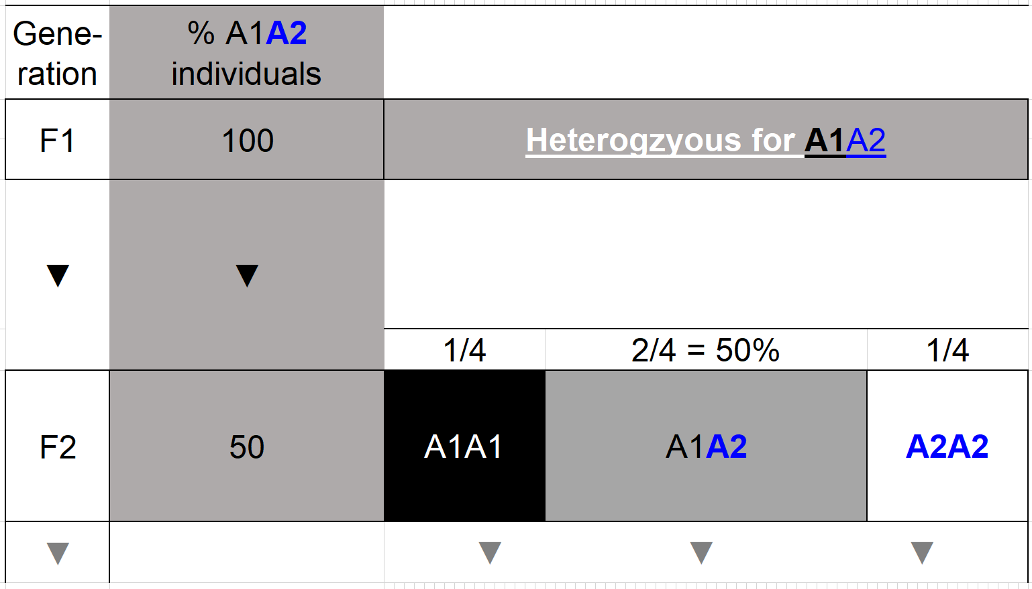
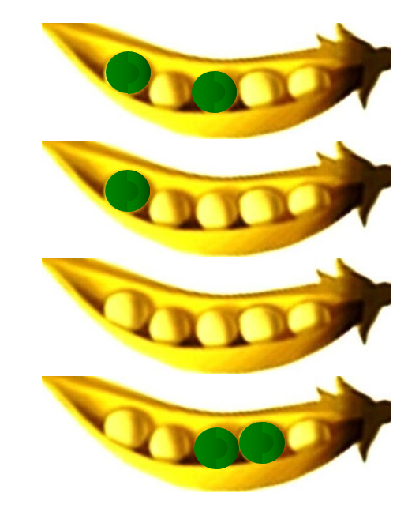
6
Self-fertilization as a major and extreme deviation from random mating. Go from the
Mendelian
Mendelian F1 via self-fertilization to the Mendelian F2.
Heterozygous for
Again: Mendelian F1-generation producing via selfing its corresponding Mendelian F2-generation.
In more quiet hours I rather type F₁ than F1.
I don't have to explain that, right? This is without selection! We take all - really all - F2 individuals (All? We take many, honestly N=∞). This is not Plant Breeding but academic consideration of the F2 generation.

Slide 7

Self-fertilization as a major and extreme deviation from Random Mating.
Selfing of A1A2
Male gametes
Heterozygous for
A1 A2
A1
A2
A1A1
A1A2
Female gametes
A2A1
A2A2
Mind you: Even the strict self-fertilization is based on a randomness concept: The female and the male gametes of the same genotype mate to each other at random! :-)
7

Slide 8
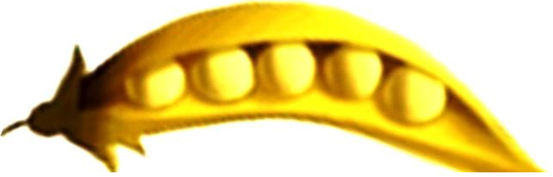
Self-fertilization as a major and extreme deviation from Random Mating.
‘A1A2’ is the Mendelian F1 gene-ration, it consists of one (or of several genetically identical) individual(s), heterozygous at that locus. Upon gamete production, gametes segre-gate, A1 and A2 gametes occur with 1:1 ratio.
Self-fertilization of F1 leads to the Mendelian 1 : 2 : 1 segregation in the once-selfed (=F2) generation. The F2 is thus at this locus for 50% of its individuals ‚still‘ heterozygous.
The F2 individual may self-fertilize again and produce the F3 generation.
Heterozygous for
Mind: No Selection, even no Mutation and no Migration. This is self-evident, because this here is theory ;-).
When ‘making’ the F3 generation, A1A1 types in F2 can only produce A1A1 for F3. A2A2 types can only produce A2A2. The A1A2 heterozygous types in F2 produce again what they did from F1 to F2 ;-) ... their offspring segregates 1 : 2 : 1. In F3, half-of-half (=1/4) of all plants will hence be 'still' heterozygous … et cetera.
8

Slide 9
This here is ongoing self-fertilization, continued selfing; beyond F₂. ... until beyond F∞.
What I explain here is anyway clear. We invest our time here only because it is important ... it is worth to be clarified, yet once and for all.
Inbreeding increases homozygosity.
Self-fertilization is the ‚hardest‘ classical version of inbreeding (full-sib mating would be a milder case).
Self-fertilization reduces heterozygosity quite fast …
… by half of what-it-is per generation of selfing.
Frequency of heterozygotes = H₀(1/2)^{(t)}
Number of t = number of selfing generations.
Mind: t=2 selfing generations do bring you to generation F3 (synon. to S2 in ‘maize-language’).
Heterozygous for
Self-fertilization means that female and male gametes that originate from the same individual (¿same genotype) mate among each other ‚at random‘. A heterozygous diploid genotype (A1A2) produces gametes ‚A1‘ and A2‘ with same frequency (we assume ‚no gamete selection‘). Hence, the offspring contains A1A1 and A2A2 with 25% each and [A1A2 or A2A1] with (together) 50%. Take an A1A2 individual. Half of its selfed offspring (once-selfing) is homozygous (at that locus). This is true, whether the A1A2 individual was or wasn’t homozygous at other (not-shown) loci (let us say: other unlinked loci). The exact segregation ratio as taught by Mendel will only occur if the number of individuals in F2 is N=∞. With, say, just four pea seeds in one pod you can‘t really expect to see the perfect 3:1 yellow-green.
9

Slide 10
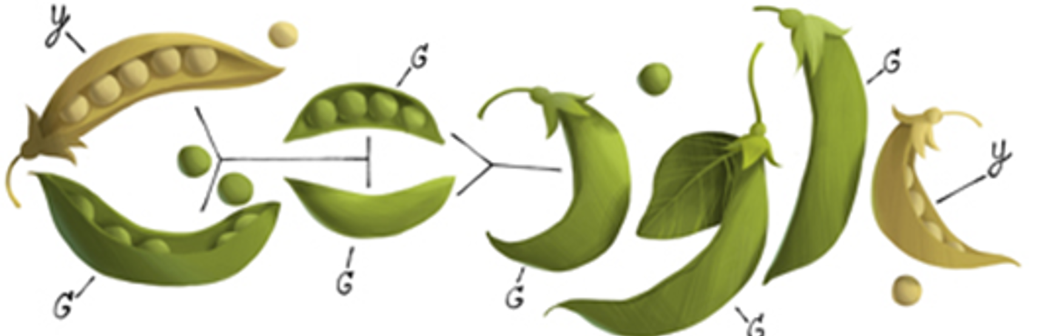
Inbreeding such as selfing decreases heterozygosity of offspring.
Per generation of self-fertilization, the extent of heterozygosity is halved (no Selection no Mutation no Drift).
For un-linked loci, this happens per locus (otherwise for groups-of-loci; i.e., for haplotypes). Consequently, the selfed offspring of a e.g. triplicate-heterozygous genotype (Aa; Bb; Cc) is expected to be …
… well, 50% of the offspring individuals should ‚still‘ be heterozygous Aa, or Bb, or Cc … but … only 0.5³ = 1/8 of the offspring is expectedly ‚still‘ heterozygous at all three loci simultaneously: Aa-Bb-Cc
Does it go without saying? This applies to diploids (and allopolyploids); much of what I say here would not apply to autopolyploids. If you are dealing with e.g. potato and alfalfa (Medicago sativa), you should be very careful and consult texts that deal with the population genetics of such special cases.
https://doodles.google/doodle/gregor-mendels-189th-birthday/
Before using this image further, please check the license terms
on Google yourself. Find the mistakes they made! Cf. page 6 ;-) ...
Here, we are in Plant Breeding. We are not in the 3‘ 5‘ Universe of Molecular Genetics
https://link.springer.com/book/9783031685972
Sometimes I write Aa, sometimes A1A2, sometimes A₁A₂, the ‚meaning‘ is (nearly) the same ;-).
I will never (again) write this below ;-) for the purpose of saying Aa …
3‘###acgttgccaaaaggaatatatcgcgcgtgtcacgtagtccagttgtgaacg###5‘
3‘###acgttgccaaaaggaatatatcgcgcgagtcacgtagtccagttgtgaacg###5‘
10

Slide 11
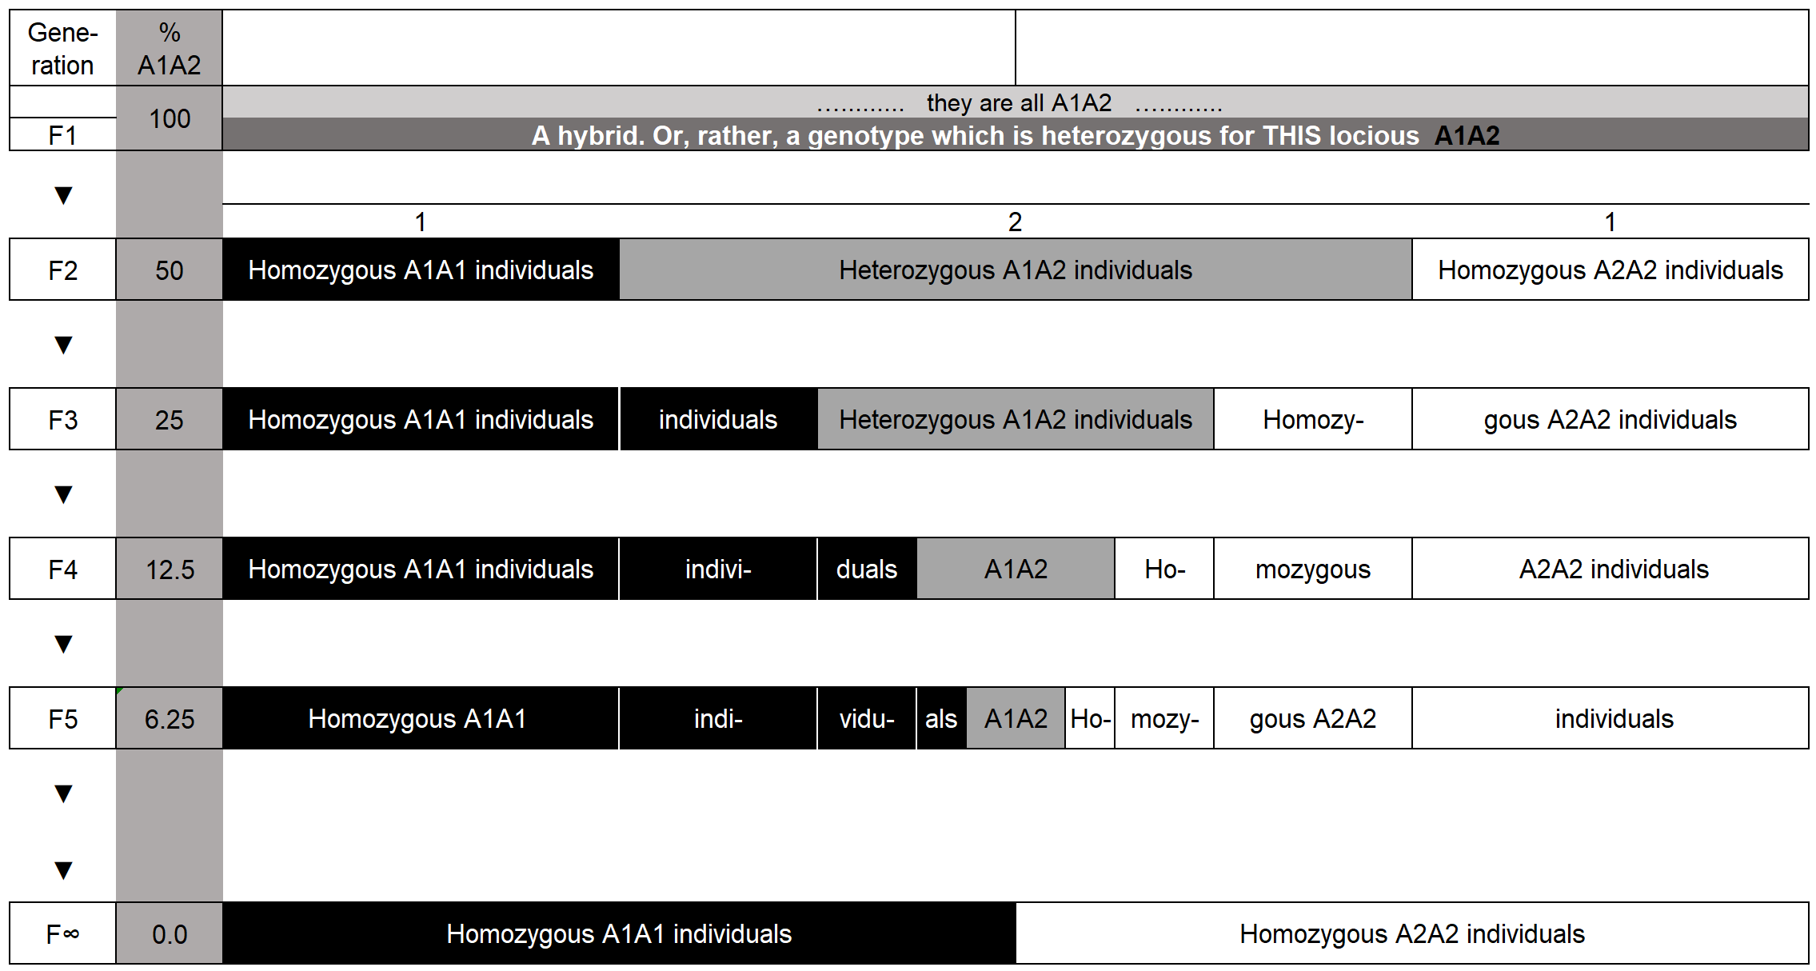
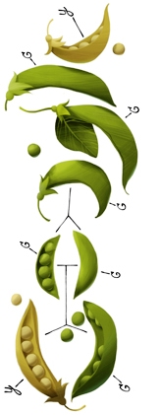
Still: Mendelian Cross, i.e. homozygous (and unrelated) parents.
It does not matter whether there are N=1, N=few or N=many A1A2-individuals in F1 because they are gene-tically identical anyway.
https://doodles.google/doodle
The % of heterozygous offspring decreases by half per generation of self-fertilization. After e.g. 7 selfings, i.e. in the filial generation F8, only 1/128 = 0.5⁷ = 0.78125% of individuals are expectedly still heterozygous at this locus.
11

Slide 12
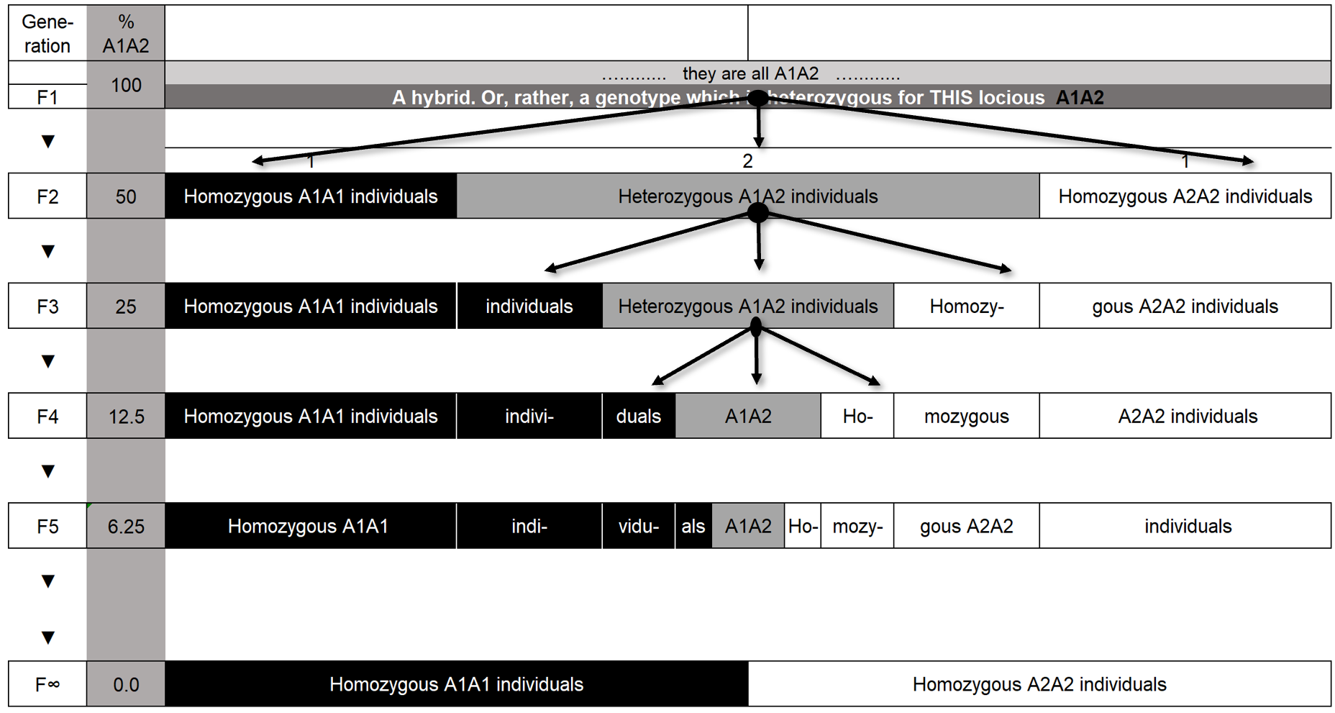
Degree of Homozygosity ≠ Inbreeding Coefficient F (unless F=1).
That much that is still heterozygous in the current generation, that much will be halved by the next selfing step (selfing=self-fertilization;
crossing=cross-fertilization).
For practical breeding, heterozygosity is considered as approx. zero in F₈ and later generations.
Let us be cautious: the ‘Degree of Homozygosity’ is not what we call „Inbreeding Coefficient F“ (see later pages).
The 1:2:1 segregation of F2 becomes eventually, in F∞, 1:1 (A1A1 : A2A2); fifty-fifty. This is a very marked deviation from p²+2pq+q². p²+2pq+q² would be ‚here‘ 1:2:1 … you see this! Indeed, here, p=q=0.5; so wow: in a Mendelian F2, we have the HWE-frequencies of genotypes. This is a strange co-incidence, useful to know.
Self-fertilization is the most extreme version of genotypic assortative mating (mating between ‚genetically similar‘ more probable than random). Assortative mating can as well be phenotypic assortative: Such as ‚those who flower at same time have a higher-than-random probability to cross among themselves‘. Phenotypic assortative mating typical-ly implies some genotypic assortative mating and produces higher-than-HWE homozygosity, at least for those loci that contribute to the segregation of the relevant trait (for instance here: flowering time).
12

Slide 13
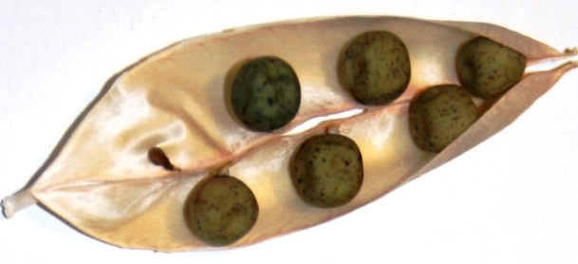
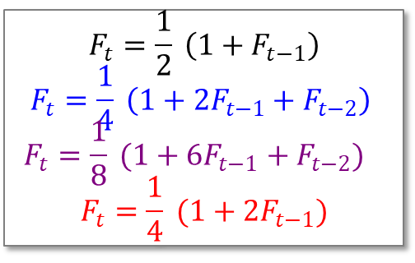
Compare repeated self-fertilization with milder versions of inbreeding.
1.000
© Urbatzka Witzenhausen
Strict repeated self-fertilizing leads to approx. full homozygosity (F=0.996) within eight generations. This is the same pattern as repeated back-crossing to a homozygous recurrent parent.
Repeated fullsib-mating is even after 20 generations only at F=0.986. Repeated halfsib-mating needs 48 generations for F=0.996.
Repeated backcrossing to a non-inbred parent does not lead to high levels of inbreeding. The more the BC generations become similar to the recurrent parent, the more this mimics the self-fertili-zation of this non-inbred type,
thus leads to F=0.5.
0.875
0.750
0.625
$$F_{t}=\frac{1}{2} \left(1+F_{t−1}\right)$$
$$F_{t}=\frac{1}{4} \left(1+{2F}_{t−1}{+ F}_{t−2}\right) \\ F_{t}=\frac{1}{8} (1+{6F}_{t−1} {+ F}_{t−2})$$
$$F_{t}=\frac{1}{4} (1+{2F}_{t−1})$$
Inbreeding Coefficient F_{t}
0.500
0.375
0.250
Self-fertilization
Fullsib-Mating
0.125
Halfsib-Mating
Backcross to Non-inbred
0.000
0
2
4
6
8
10
12
14
16
18
20
22
Inbreeding Generation t
13

Slide 14
Self-fertilization reduces the current-extent of heterozygosity by half. No other type of inbreeding is ‚mightier‘ (well, we exclude DH technology here).
If a genotype is heterozygous at 20% of its, say, 30.000 loci (6.000 heterozy-gous loci), then after once selfing* the extent of heterozygosity of its offspring will be ~10% (3.000 loci; after 14 generations of self-fertilization, the majority of its individuals - about 69% - is then homozygous at all of these 30.000 loci; across the entire genome).
One and two selfings lead to a reduction of heterozygosity to 50% and 25% of the initial value. We need 3 generations of full-sib mating for a 50% reduction and 5 or 6 generations of half-sib mating to reduce by ~45% or ~51%. For an approx. reduction down to 25%, we need 6 to 7 generations of full-sib mating or 11 to 12 generation of half-sib mating.
If we assume zero linkage throughout, then we need not care how-exactly a specific reduction of heterozygosity was created (selfing, sib-mating, ...).
*No Selection no Mutation no Migration no Drift
14

Slide 15
15
Self-fertilization reduces the current-extent of heterozygosity by half. No other type of inbreeding is ‚mightier‘ (well, we exclude DH technology here).
If a family of genotypes is – at one focal locus – heterozygous at 20% of its 30.000 individuals (6.000 individuals are Aa), then after once selfing* the extent of heterozygosity of its offspring will be ~10% (~3.000 individuals*; after 14 generations of self-fertilization, only 0.4 individuals are expectedly still Aa, thus very probably none).
One and two selfings lead to a reduction of heterozygous individuals to 50% and 25% of the initial number (or proportion). We need 3 generations of full-sib mating for a 50% reduction and 5 or 6 generations of half-sib mating to reduce by ~45% or ~51%. For an approx. reduction down to 25%, we need 6 to 7 generations of full-sib mating or 11 to 12 generation of half-sib mating.
As we considered just one locus, thus here we do not care how-exactly a specific reduction of heterozygosity was created.
*No Selection no Mutation no Migragion no Drift
*We took one random selfed offspring from each

Slide 16
We now jump! We jump in perspective between
per one genotype: Average across many or all of its loci.
per generation, population, family: One locus, average across many or all of its individuals.
If a genotype is – heterozygous at 20% of its 30.000 loci (6.000 heterozygous loci), then after once selfing the extent of heterozygosity of its offspring will be ~10% (3.000 loci).
If a family of genotypes is – at a specific locus – heterozygous at 20% of its 30.000 individuals (6.000 individuals are Aa), then after once selfing the extent of heterozygosity of its offspring will be ~10% (~3.000 individuals).
16

Slide 17

Many crops such as wheat, rice and lentil are naturally self-fertilizing species. …
Even ‘strict’ self-fertilizing species such as lentil, Lens culinaris, allow a bit of cross-fertilization
(DOI 10.1111/j.1439-0523.2006.01290.x)
which is a necessity for evolution and coherence of population et cetera.
… Plants of these self-fertilizing species
are thus mostly and highly homozygous.
If a hybrid plant occurs (as rare natural
event or after artificial crossing), then after
few generations of self-fertilizing, off-spring
will be (again) highly homozygous; even
with Selection, Drift, Mutation, Migration.
If you feel that the highly homozygous F_{>8} offspring of a hybrid ancestor is genetically homogeneous, then you will want to study deeper. See, here, we talked about the entire offspring, the total inbred bulk, not about a single inbred line that may stem from that F1. We come to this again when talking about ‘Line Breeding’.
© Urbatzka
17

Slide 18
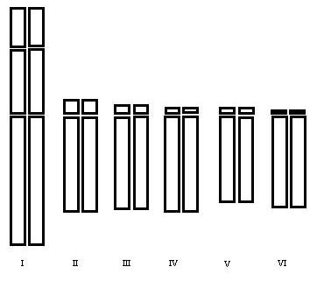
Is homozygosity at all (many) loci simultaneously a real option or just theory?
Allard (1999, Principles of Plant Breeding, Wiley, Now York) shows: Being homozygous at all of many loci simultaneously is a reality, it is just a matter of patience.
After one generation of selfing, 50% of offspring individuals are expectedly homozygous (at a formerly heterozy-gous locus). One selfing brings 0.50.5 = 0.25 = 25% of F2 to homozygosity at both of 2 loci. It brings 0.5⁴ = 6.25% to quadruple-homozygosity. In case of higher number of loci, the geneticist needs some patience, yet, after 10 or more generations of repeated strict self-fertilization, she sees that the majority of the loci are homozygous in the majority of the plants. Today, with DH technology (see later), we tend to mildly smile, seeing this lengthy process.
Genome-wide
18

Slide 19

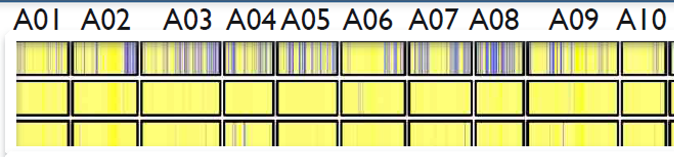
Marker-based extent of heterozygosity of the A-genome of a B. napus F1-hybrid and its parents (Snowdon et al., 2015, Giessen)
Chromosomes A01 to A10; yellow indicates homozygous region, blue heterozygous region
C-genome not shown
F1
P1
P2
19
When talking in Mendel‘s sense, we assume that parents are homozygous – a necessary condition to realize the Mendelian rule of „uniform F1“. You know this. Mendel was lucky to work with pea, since pea, a self-fertilizing crop, is by nature homozygous, just as needed to detect the Mendelian rules. We furthermore assume that the F1 is heterozygous, which is a necessity, otherwise the F2 would not segregate – and it is the genetic segregation that is of interest. However …
The F1 is only heterozygous for those very loci which are (were) different between its parents. If parents did not differ, for instance if both pea parents were green-seeded, then their F1 is homozygous at that locus and their F2 etc. does not segregate (for that feature).
Beyond the side-fact that, here, parents were not 100% homozygous (not fully yellow) you see: this Brassica F1 is indeed at many chromosomal regions heterozygous (blue). But it is very far from 100% heterozygous. Parents that differ for all genes, hence F1 which is 100% (genome-wide) heterozygous is a Fata Morgana. Good to understand.

Slide 20
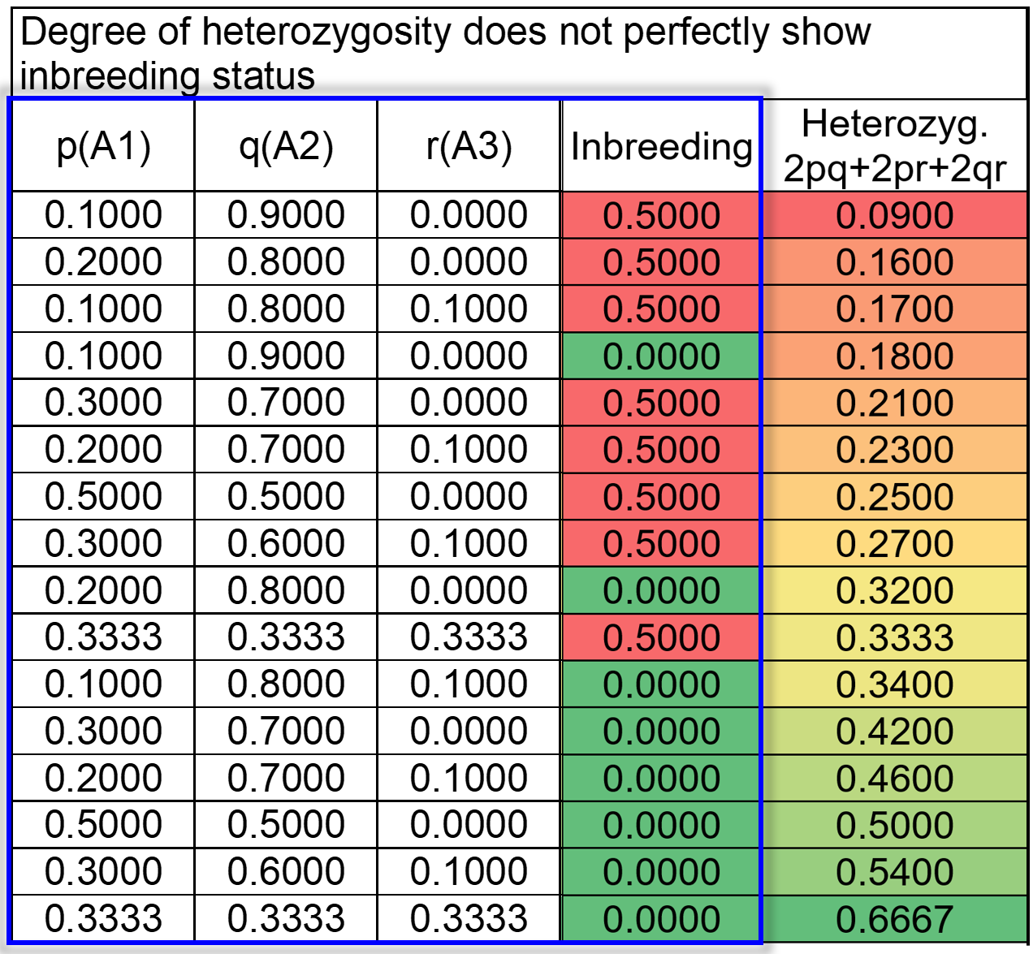
Soon we will see that Degree of Heterozygosity ≠ Panmictic Index.
Remember: All plants of a ‘true’ HWE equilibrium population are zero inbred. This follows from concept and definition … from the setting that the HWE population has N=∞ members and hence, the probability of mating among parents which are genetically related (cousins et cetera) is zero.
Obviously, with two alleles and p=10%, in HWE we expect 18% heterozygotes (forth line in table), which is much less than the 25% which we expect after one selfing yet with p=q=50% (i.e., at F=0.5-level of inbreeding; seventh line in table).
We even can have 1/3 individuals heterozygous after one selfing, since with 3 alleles of same frequency, HWE (i.e. zero inbreeding) expects 2/3 of heterozygous plants (tenth line; remember: one selfing halves current heterozygosity).
The absolute level of heterozygosity does not well inform us about the inbreeding status of the material. And heterozygosity does not reach 100% as maximum.
20

Slide 21
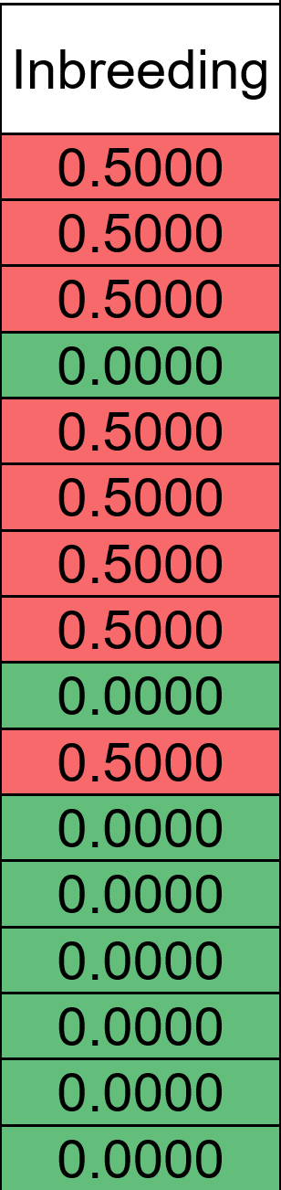
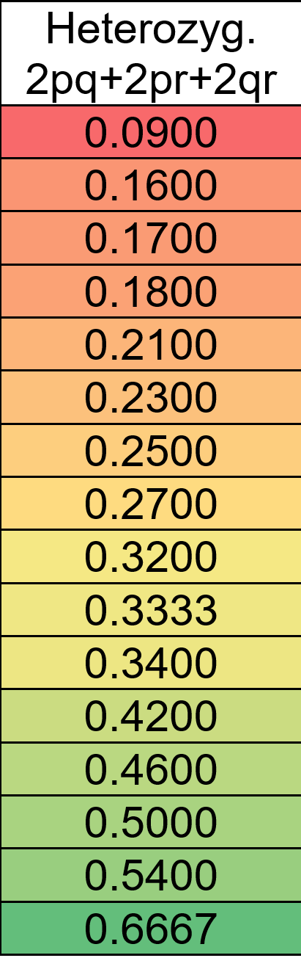
The percentage of heterozygsity at a locus is no perfect information about the inbreeding status of the material (Note: We have two or three alleles here, just for fun).
Remember: All plants of a ‘true’ HWE equilibrium population are zero inbred. This follows from concept and definition … from the setting that the HWE population has N=∞ members and hence, the probability of mating among parents which are genetically related (cousins et cetera) is zero.
Obviously, with two alleles and p=10%, in HWE we expect 18% heterozygotes (forth line in table), which is much less than the 25% which we expect after one selfing yet with p=q=50% (i.e., at F=0.5-level of inbreeding; seventh line in table).
We even can have 1/3 individuals heterozygous after one selfing, since with 3 alleles of same frequency, HWE (i.e. zero inbreeding) expects 2/3 of heterozygous plants (tenth line; remember: one selfing halves current heterozygosity).
The absolute level of heterozygosity does not well inform us about the inbreeding status of the material. And heterozygosity does not reach 100% as maximum.
21

Slide 22
The percentage of heterozygsity at a locus is no perfect information about the inbreeding status of the material.
Remember: All plants of a ‘true’ HWE equilibrium population are zero inbred. This follows from concept and definition … from the setting that the HWE population has N=∞ members and hence, the probability of mating among individuals which are related (cousins et cetera) is zero.
Obviously, with two alleles and p=0.10, in HWE we expect 18% heterozygotes (F=0.0), which is less than the 25% which we expect after one selfing yet with p=q=50% (i.e., at F=0.5-level of inbreeding).
We even can have 1/3 individuals heterozygous after once selfing, with 3 alleles of same frequency and F=0.5. You see: In HWE, (i.e. zero inbreeding), 2/3 of heterozygous plants are expected, and once selfing brings us to F=0.5 and to halved current heterozygosity: from 2/3 to 1/3 = 0.3333.
The absolute level of heterozygosity does not well inform us about the inbreeding status of the material. And heterozygosity does not reach 100% as maximum.
22

Slide 23
Although we like to have a scale from 0 to 1 (0% to 100%), heterozygosity can not be 100%. Hence, we employ a ‚substitute-parameter‘ to allow us a 0-1 scale.
Scenario: p=0.3
Panmictic
index
0
0.25
0.50
1.0
1
Inbreeding
coefficient
0.75
0.50
0
Hetero-
zygosity (%)
2pq
0.252pq
0.502pq
0
0.105
0.21
0.42
1
Homozy-
gosity (%)
0.895
0.79
p²+q²
0.58
23

Slide 24
Although we like to have a scale from 0 to 1 (0% to 100%), heterozygosity can not be 100%. Hence, we employ a ‚substitute-parameter‘ to allow us a 0-1 scale.
Panmictic
index
0
0.25
0.50
1.0
1
Inbreeding
coefficient
0.75
0.50
0
Hetero-
zygosity (%)
2pq
0.252pq
0.502pq
0
Case: p=0.3
0.105
0.21
0.42
1
Homozy-
gosity (%)
0.895
0.79
0.58
Percent heterozygosity can not reach 100% in a population. Not for a single locus (unless the entire population was created by controlled crossing between different-and-homozygous parents), and not for all genes simultaneously (probably really impossible. You know why, don’t you). Therefore … a ‘substitute’ parameter. Panmictic index P substitutes for heterozygosity. Inbreeding coefficient F substitutes for homozygosity. Panmictic index P=1 means zero inbreeding (P=1-F), hence, P=1 if H=2pq. Inbreeding coefficient F=1 means: Max. inbreeding. Homozygosity is 100%. Yes, at the inbred-end of scale, the two perspectives collapse: 100% homozygosity is biologically possible, and there, inbreeding coefficient F=1. H=1 (100% heterozygosity) is a Fata Morgana, hence P=1 is at H=2pq
instead of at H=1 (instead of at H=100%; because; again, H=100% does not occur. No, it doesn’t). ☺
24

Slide 25
Although we like to have a scale from 0 to 1 (0% to 100%), heterozygosity can not be 100%. Hence, we employ a ‚substitute-parameter‘ to allow us a 0-1 scale.
Panmictic
index
0
0.25
0.50
1.0
1
Inbreeding
coefficient
0.75
0.50
0
Hetero-
zygosity (%)
2pq
0.252pq
0.502pq
0
0.105
0.21
0.42
1
Homozy-
gosity (%)
0.895
0.79
0.58
25
We say ‘P=1’ if heterozygosity reaches 2pq, for instance 42% (if p=0.7; q=0.3). This implies that the 100-42=58% of homozygous individuals in such non-inbred population are not indicative of inbreeding although they are homozy-gous. The reasoning is: Well, they are homozygous such as A1A1 and A2A2. But, such A1A1 (or A2A2) individuals inherited their two ‘same’-alleles from parents which were not related to each other; from parents that did not have common ancestors (in the range of pedigrees that we know). We now make a difference between two alleles that are ‘same’ yet were not inherited from a common ancestor … and two alleles which are ‘same’ yet the reason of being same is: They are copies from the very same ancestral gene and made their way from this ancestor to our focal genotype with its current homozygosity.

Slide 26
 Alike in State (ais)
 Identical by Descent (ibd)
https://cnsgenomics.com/data/teaching/SISG/module_1/Module01-Lecture-Notes.pdf
26

Slide 27
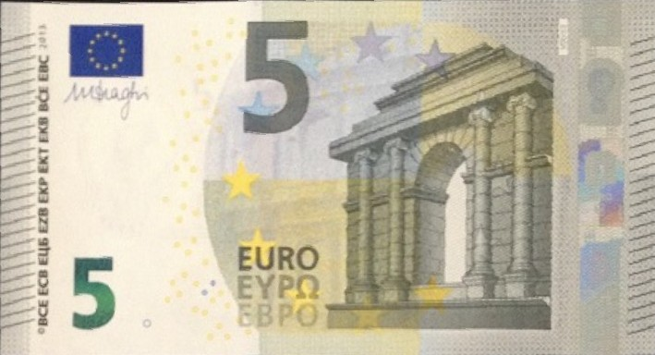

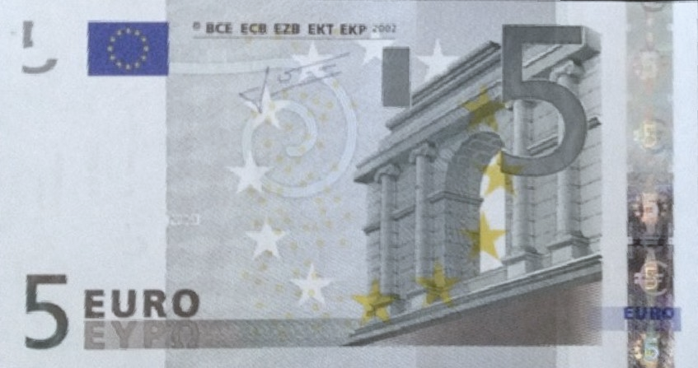
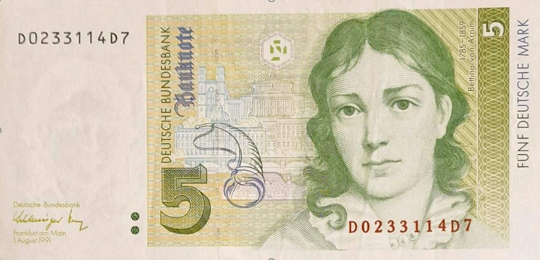
‘All ... are equal, but some ... are more equal than others’
A quote from 'Animal Farm' by George Orwell, addressing hypocrisy (Heuchelei) of those in power - who untruthfully claim that ‘everyone is equal’.
Banknotes from same or different printing plates with same purchasing power;
or altogether different banknotes (different purchasing power) ► ibd, ais.
27
A1_{(*2019)} A1 _{(*2019)}
A1_{(*2019)} A1_{(*2000)}
A1_{(*2019)} A2 _{(*1991)}
‚Identical by Descent‘
and hence anyway
‚Alike in State‘
‚Alike in State‘ but not ‚Identical by Descent‘
Un-like in State
hence anyway not
Identical by Descent
DM
In 2000, € notes came, in 2019 we got new € notes with new security features (before: DM )

Slide 28
If ibd, then alleles are exactly same (no Mutation), with exactly same effect on pheno-type. If not ibd but ais, then alleles have still same effect on phenotpye yet may have changed minimally since they were once in the distant past ibd; e.g., a point mutation changed the codon CTT to CTC or CTA or CTG (all coding for leucin; silent change).
28
A1_{(*2019)} A1 _{(*2019)}
A1_{(*2019)} A1_{(*2000)}
A1_{(*2019)} A2 _{(*1991)}
‚Identical by Descent‘
and hence anyway
‚Alike in State‘
‚Alike in State‘ but not ‚Identical by Descent‘
Un-like in State
hence anyway not
Identical by Descent
DM
Homozygous
Inbreeding-relevant
Homozygous
Inbreeding-irrelevant
Heterozygous

Slide 29
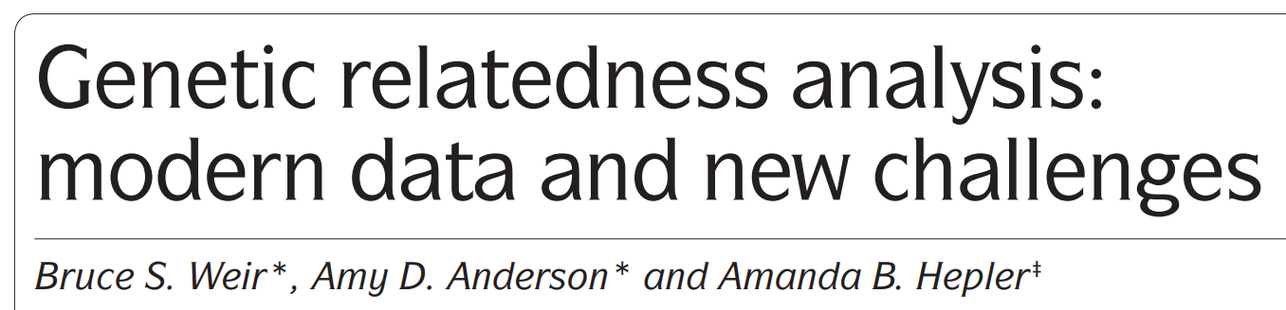
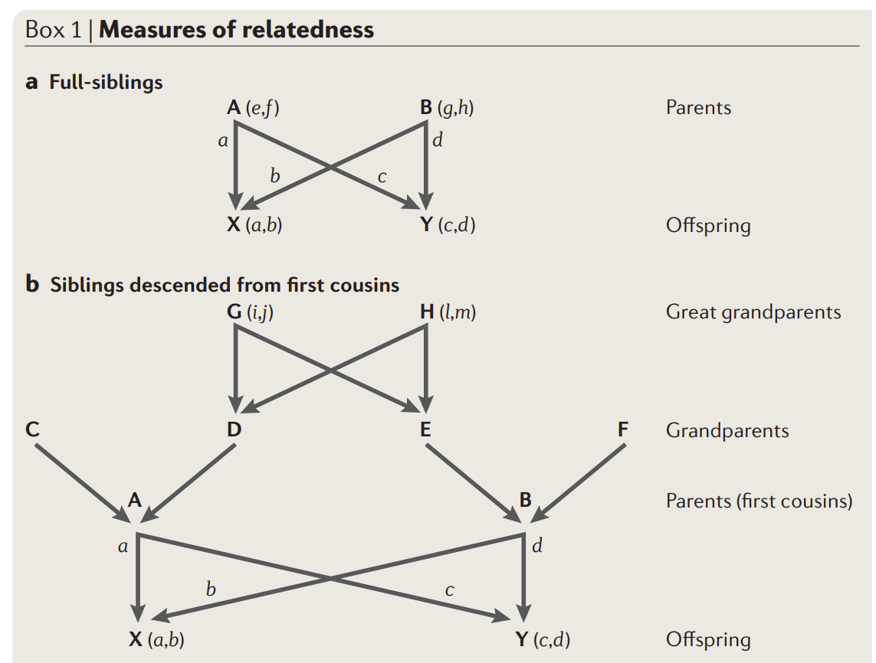
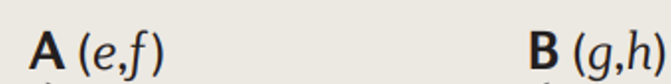
Kinship aka coancestry aka coefficient of consanguinity
The so-called kinship of two individuals X and Y, f _{(AB)} is identical with the inbreeding coefficient F_{(X)} of their progeny X: f_{(AB)} = F_{(X)} (= F_{(Y)}).
If A and B are unrelated, then their offspring is non-inbred (whatever the inbreeding of A and B may be; … be cautious, this apodictic statement does not apply for auto-polyploids such as potato: we need haploid gametes to non-transmit ‘zygosity’ from parent plant via gamete to offspring).
An important point is:
The kinship of an individual A to itself f_{(AA)} is the inbreeding coefficient of the offspring from mating the individual A to itself (self-fertilization).
If individual is non-inbred: f _{(AA)} = ½
If individual is homozygous: f _{(AA)} = 1
If 0 < F_{(A)} < 1: then f _{(AA)} = ½ [1 + F_{(A)} ]
Hence, for the kinship of an individual to itself,
we have ½ ≤ f _{(AA)} ≤ 1.
https://www.nature.com/
articles/nrg1960
29

Slide 30
We now look at changes in frequency of homozygotes, caused by one step of self-fertilization, and how, where, inasmuch … this reflects change of inbreeding.
We will see that the up and down of homozygosity is only indicative for up and down of inbreeding if we follow the identical-by-descent related homozygosity and ignore the alike-in-state related levels of homozygosity.
Let us see ...
30

Slide 31
We inspect the offspring from self-fertilization and ponder about alike-in-state and identical-by-descent type of homozygosity ☺
A₀₁A₀₁ and the like are homozygous for alleles which are identical by descent (ibd).
A₀₁A₀₂ and the like are homozygous for alleles which are alike in state (ais).
Alike in State (zustandsgleich) is a lesser level of being „same“ than Identical by Descent (abstammungsgleich).
If alleles are ibd, then they are ais anyway
(assume: no Mutation).
A₀₇a₀₈ and the like are heterozygous genotypes.
1:1:1:1
31

Slide 32
We inspect the offspring from self-fertilization and ponder about alike-in-state and identical-by-descent type of homozygosity ☺
Five genotypes of a Reference Population, so we have examples to demonstrate (A₀₁A₀₂ et cetera).
Genotypes are AA or Aa or aa. Imagine a monogenic resistance, such as A codes for resistance, a codes for susceptibility.
Yet. We noted in addition (as subscript) the actual identity (numbers from ₀₁ up to ₁₄) of that very ancestral individual from which such allele was inherited.
A₀₁A₀₂ inherited its two resistance-alleles from two different ancestors (#01; #02).
Upon selfing, this A₀₁A₀₂ genotype will not segregate for resistance, because it is homozygously resistant. It is homozygous for two alleles which are alike in state (ais).
1:1:1:1
Nevertheless, its offspring segregates: For this subscript-ancestral-identity. One fourth of offspring is expectedly homozygous A₀₁A₀₁. A second ¼ is homozygous A₀₂A₀₂; half is not homozygous in this (strange) sense.
Now take the A₀₅a₀₆ individual. Those of its offspring (from selfing) who indeed are homozygous are so for identitical-by-descent (ibd) alleles (such as A₀₅A₀₅).
Half of each selfed offspring is homozygous for ibd, whether the parental genotype was actually homozygous (ais) or heterozygous. Selfing creates 50% homozygosity of the ibd type. THIS is what is the inbreeding-relevant type of homozygosity. Later more one this.
32

Slide 33
We inspect the offspring from self-fertilization and ponder about alike-in-state and identical-by-descent type of homozygosity ☺
1:1:1:1
Nevertheless, its offspring segregate: for this subscript-ancestral-identity. One fourth of offspring is expectedly homozygous A₀₁A₀₁. A second forth is homozygous A₀₂A₀₂; half is not homozygous in this (strange) sense.
Now take the A₀₅a₀₆ individual. Those of its offspring (from selfing) who indeed are homozygous are so for identitical-by-descent (ibd) alleles (such as A₀₅A₀₅). Half of each selfed offspring is homozygous for ibd, whether the parental genotype was actuall homozygous (ais) or heterozygous.
Selfing creates 50% homozygosity of the ibd type. THIS is what is the inbreeding-relevant type of homozygosity.
Later more one this.
33

Slide 34
We inspect the offspring from self-fertilization and ponder about alike-in-state and identical-by-descent type of homozygosity ☺
1:1:1:1
Nevertheless, its offspring segregate: for this subscript-ancestral-identity. One fourth of offspring is expectedly homozygous A₀₁A₀₁. A second forth is homozygous A₀₂A₀₂; half is not homozygous in this (strange) sense.
Now take the A₀₅a₀₆ individual. Those of its offspring (from selfing) who indeed are homozygous are so for identitical-by-descent (ibd) alleles (such as A₀₅A₀₅). Half of each selfed offspring is homozygous for ibd, whether the parental genotype was actuall homozygous (ais) or heterozygous.
A sligthly different way to show the same idea ;-)
34

Slide 35
There is more that could be said about ‘ais’ and ‘ibd’.
Several of my brighter colleagues neglect or even dislike this concept; they say ‘it is useless’ or ‘meanwhile useless,’ it has ‘not biological meaning’.
We may talk again about this as we know more about LD, haplotypes, linkage drag, about prediction of the chromosomal neighbourhood from knowledge about a given (marker) locus, about phasing and imputing.
35

Slide 36
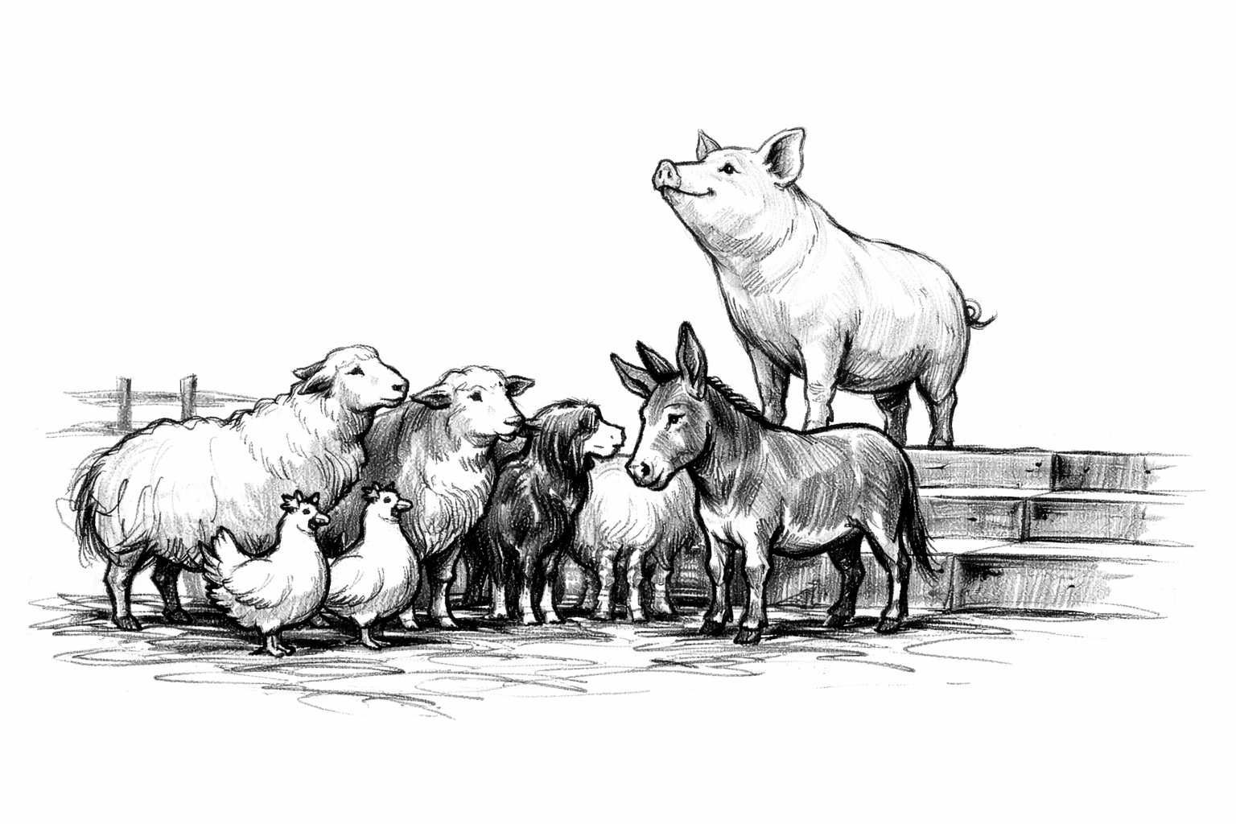
From here you may go to UNPLAB-PopGen_Ch-4[Drift I]
George Orwells „Animal Farm“:
All animals are equal, but some animals are more equal than others.
36

